Slide 1
Basic Inorganic Chemistry For B.Tech & B.Sc I yr
Coordination Chemistry
(4 lectures)
Crystal field theory, Crystal Field Stabilization Energy, Explaining physical properties, magnetic properties, distortion of shape and color of complexes using CFT
Prepared by Prof. Anil J. Elias, IIT Delhi

Slide 2
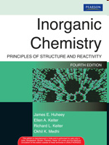
Text books for Inorganic Chemistry
J. E. Huheey
Keiter & Keiter
B.D.Gupta
A. J. Elias

Slide 3
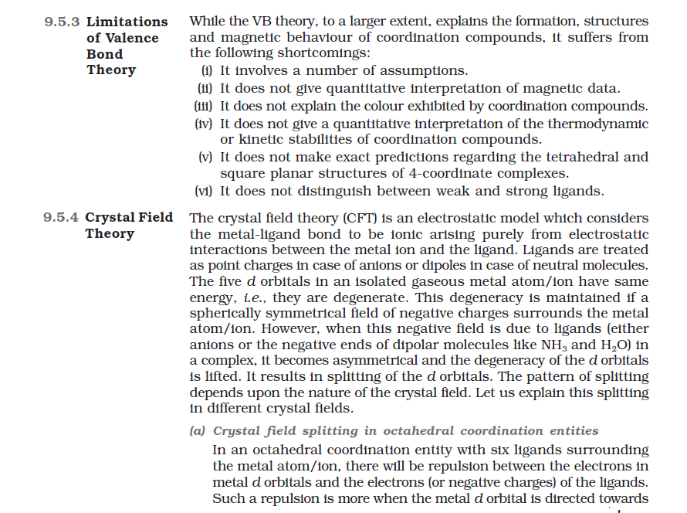
Background requirement: +2 level CBSE/ICSE and JEE advanced syllabus level
NCERT CHEMISTRY Class 12 Textbook Book 1

Slide 4
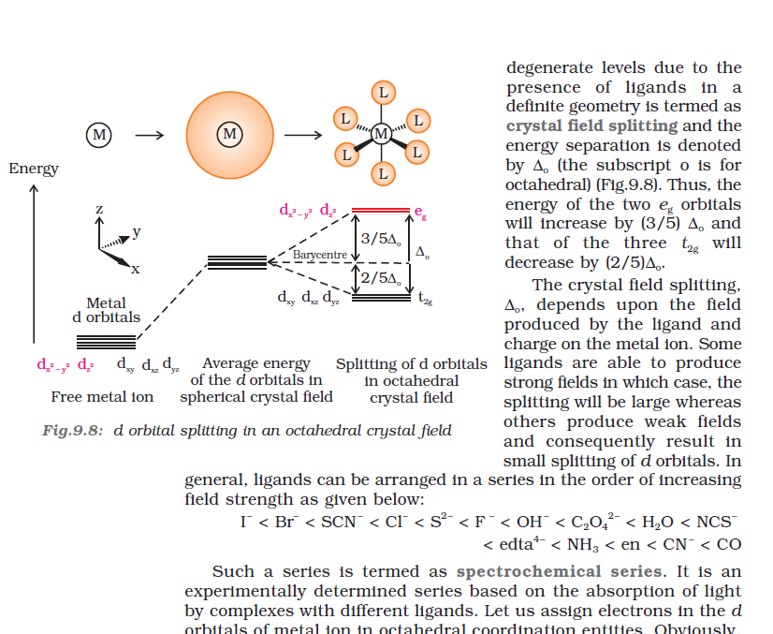
NCERT CHEMISTRY Class 12 Textbook Book 1

Slide 5
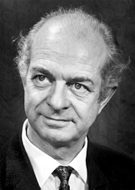
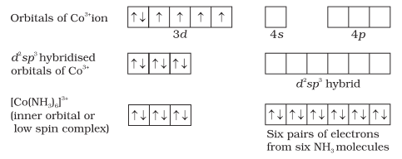
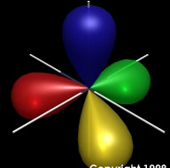
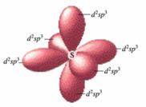
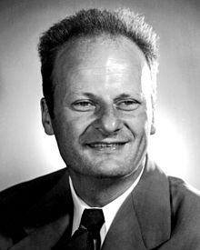
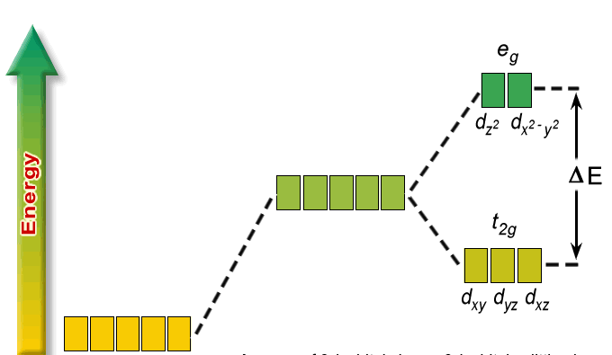
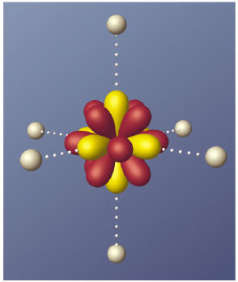
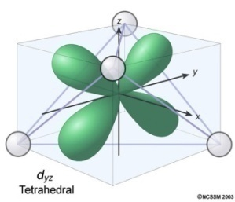
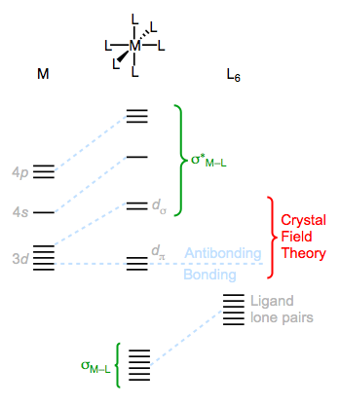
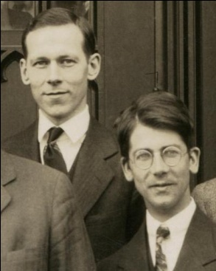
Theories of Bonding in transition metal complexes
Theories of bonding were proposed and used to explain the observed properties of transition metal complexes such as color, magnetism, shape of complexes
Valence bond theory
Linus Pauling
Nobel 1954,1962
Crystal Field theory
Hans Bethe
Nobel 1967
Molecular Orbital Theory
Mulliken (Nobel 1966) & Hund

Slide 6
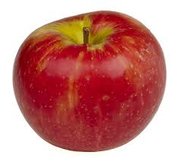
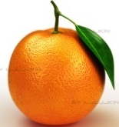
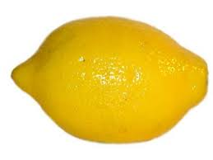
Theories of bonding in transition metal complexes – in a nutshell
to explain the observed properties of the metal complexes such as color, magnetism, shape
Valence bond theory
Based on the concept of hybridization sp³, dsp², dsp³, d²sp³ & sp³d² : Predicts shapes of complexes very efficiently
Can determine magnetic moment if hybridization is known and vice versa
Does not explain color of complexes, distortion of shape of complexes
Does not predict strength of ligands or temperature dependence of magnetic moments
Linus Pauling
Crystal Field theory
Basic assumptions: Ligands and metal are point charges and the attraction between them is purely electrostatic in nature
Considers how the energies of the five metal d orbitals change in the presence of a ligand field (removing /lifting of the degeneracy).
Provides explanation to color, arranges ligands according to their strength, explains distortion of complexes and anomalies in their physical properties
VBT and CFT should not be MIXED: A common mistake done by many students
Ajoy Ghatak
Hans Bethe
Molecular Orbital Theory
A larger picture where both metal orbitals and ligand group orbitals are made to form bonding, non bonding and antibonding orbitals.
CFT splitting is included in this picture; also orbital overlap: π bonding
Explains color, magnetism and energetics (does not predict shape)
Mulliken & Hund

Slide 7
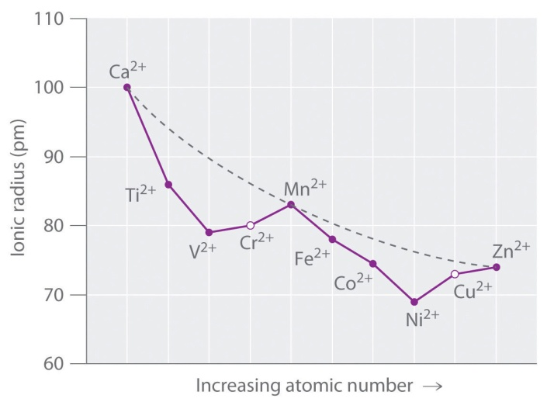
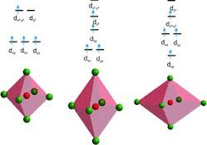
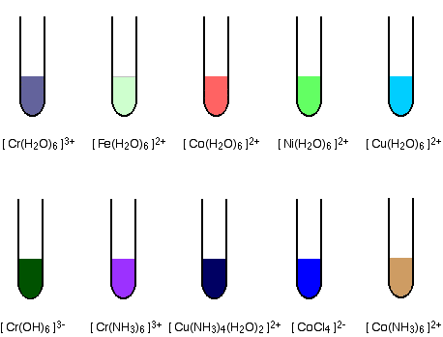
Finding an explanation for the observed properties of transition metal complexes using Crystal Field Theory
Variation of some physical properties of metal complexes across a period
Magnetic properties of complexes
Temperature dependence of magnetic moments
Distortion in the shape of complexes
Color of metal complexes

Slide 8
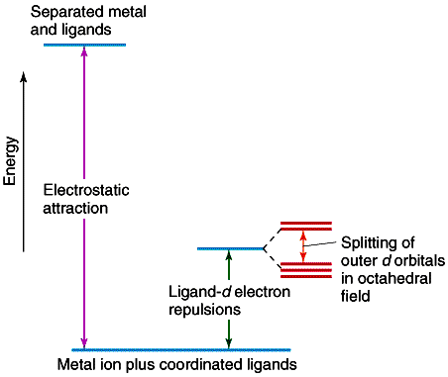
Energetics involved in the CFT model
Basic Assumptions of Crystal Field theory ( concept borrowed from solid state physics)
The ligands and the metal are considered as point charges
The attraction between the metal and the ligands is purely electrostatic
Properties of the metal complexes are explained based on changes happening to the d orbitals of the metal only
i) Separated metal and ligands at high energy
ii) Electrostatic attraction between metal and ligands leading to stabilization (heart of CFT)
iii) Destabilization due to ligand electrons- metal d electrons repulsion in a spherical field
iv) Further splitting of the 5 d orbitals to 2 sets due to an octahedral field.
i
iv
iii
ii

Slide 9
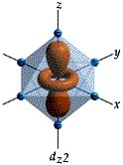
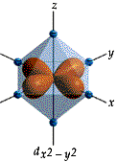
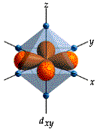
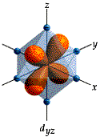
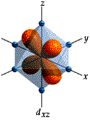
Orbitals affected when ligands approach a metal in an octahedral arrangement
Ligands with their pair of electrons approach the metal along the X, Y and Z axes for an octahedral complex formation
d-orbitals having lobes pointing directly at x,y and z axis are repelled most by electron-electron repulsion
d-orbitals not pointing directly at x, y and z axis are
stabilized to maintain the overall energy same

Slide 10
Splitting of the d-orbitals in an octahedral field
d - orbitals splitting in an
octahedral crystal field
e_{g}
Energy
d - orbitals in a spherical field of six ligands
d _{x}² _{– y}² d _{z}²
+0.6Δ_{o}
Δ_{o} or 10Dq
-0.4Δ_{o}
d - orbitals stabilized by metal- ligand electrostatic attraction
d _{xy} d _{yz} d _{xz}
t_{2g}
t_{2g} : triply degenerate set of orbitals :
e_{g} doubly degenerate set of orbitals
g= gerade: symmetric with respect to the centre of inversion
u= ungerade : antisymmetric w. r. t the centre of inversion
Barycenter: A point between objects where they balance each other

Slide 11
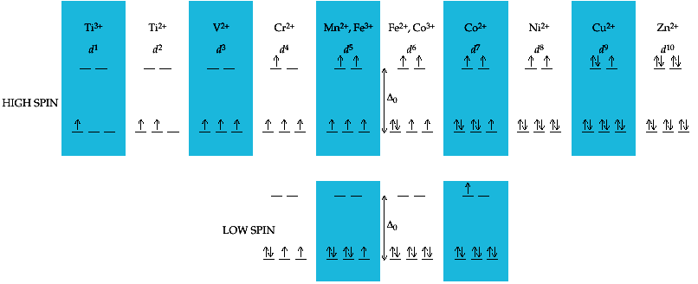
High Spin Vs. Low Spin (d¹ to d¹⁰)
When does a complex prefer High Spin/ low spin arrangement of electrons?
Δ_{o} < Pairing energy : High Spin Δ_{o} > Pairing Energy : Low Spin
Δ_{o} P
[Fe(H₂O)₆ ]²⁺ d⁶ 9350 19150 High Spin
[Fe(CN)₆ ]⁴⁻ d⁶ 32200 19150 Low Spin
Δ_{o} < P
Δ_{o} > P

Slide 12
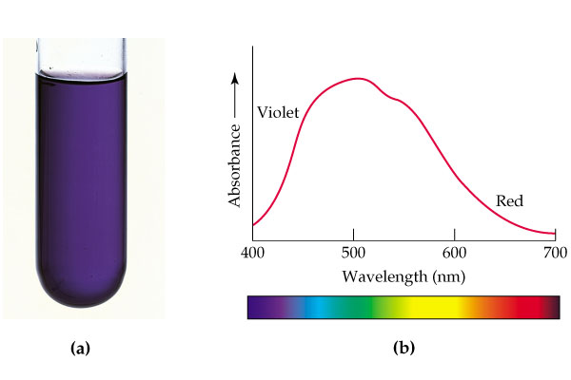
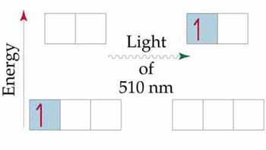
Significance of Δ_{o} and its physical measurement
Electronic spectrum of [Ti(H₂O)₆]³⁺
e_{g}
3d¹4s⁰
t_{2g}
494 nm = 20,300 cm⁻¹
UV –Visible Spectroscopy
1 kj = 83.7 cm⁻¹
[Ti(H₂O)₆]³⁺ Δ_{o} = 20,300 cm⁻¹ = 243 kj/mol
Since an electron in the t_{2g} set is stabilized by -0.4 Δ_{o} 243 X -0.4 = -97 kj/mol
The complex is stabilized to the extent of 97 kj/mol compared to a hypothetical spherical field due to the splitting of the d orbitals; This extra stablization of the complex is called crystal field stablization energy (CFSE)
t_{2g}¹e_{g}⁰
t_{2g}⁰e_{g}¹
Because the sample absorbs most strongly around the green region of the visible spectrum, it appears purple.

Slide 13
Crystal Field Stabilization Energy : The d⁴ Case
Weak Field/ High Spin
Strong Field/Low Spin
Δ_{o} > P
Δ_{o} < P
Energy
e_{g}
e_{g}
+0.6Δ_{o}
+0.6Δ_{o}
-0.4Δ_{o}
-0.4Δ_{o}
t_{2g}
t_{2g}
t_{2g}³e_{g}¹
t_{2g}⁴e_{g}⁰
CFSE = -1.2 Δ_{o} + 0.6Δ_{o}
= - 0.6 Δ_{o}
CFSE = -1.6 Δ_{o} + 1 pairing
= - 1.6 Δ_{o} + P

Slide 14
What is Pairing Energy, P?
The pairing energy is not an experimentally obtained value like Δ_{o} and is same for a metal ion irrespective of the ligands. It is made up of two terms.
The inherent coulombic repulsion that must be overcome when two electrons are forced to occupy the same orbital. (Destabilizing energy contribution of P_{c} for each doubly occupied orbital).
Loss of exchange energy ( based on Hunds rule) that occurs as two electrons with parallel spin (↑↑) are forced to become antiparrallel (↑↓) in an orbital. (contribution of P_{e} for each pair having same spin and same energy)
P = sum of all P_{c} and P_{e} interactions

Slide 15
The d⁵ and d⁶ low spin cases and the correct way to determine pairing energy contribution
+0.6Δ_{o}
+0.6Δ_{o}
-0.4Δ_{o}
-0.4Δ_{o}
CFSE = -2.0Δ_{o} +2P
CFSE = -2.4Δ_{o} +2P
CFSE = -2.4Δ_{o} +3P
Always compare the extent of pairing with the situation before the splitting of five d orbitals occurred

Slide 16
The crystal field stabilization energy (CFSE)
The stability that results from placing a transition metal ion in the crystal field generated by a set of ligands.
It arises due to the fact that when the d-orbitals are split in a ligand field, some of them become lower in energy than before with respect to a spherical field in which all five d-orbitals were degenerate.
For example, in an octahedral case, the t_{2g} set becomes lower in energy with respect to the barycenter. As a result, if there are any electrons occupying these t_{2g}orbitals, the metal ion is more stable in the ligand field relative to the barycenter by an amount known as the CFSE.
Conversely, the e_{g} orbitals (in the octahedral case) are higher in energy with respect to the barycenter, so having electrons in these orbitals reduces the amount of CFSE.

Slide 17
d^{n} | Mag moment | Elec. Config. | CFSE
d¹ | 1.73 BM | t_{2g}¹ | -0.4 Δ_{o}
d² | 2.83 BM | t_{2g}² | -0.8 Δ_{o}
d³ | 3.87 BM | t_{2g}³ | -1.2 Δ_{o}
d⁴ | 4.90 BM | t_{2g}³ e_{g}¹ | -0.6 Δ_{o}
d⁴ LS | 2.83 BM | t_{2g}⁴ | -1.6 Δ_{o} +P
d⁵ | 5.92 BM | t_{2g}³ e_{g}² | 0
d⁵ LS | 1.73 BM | t_{2g}⁵ | -2.0 Δ_{o} +2P
d⁶ | 4.90 BM | t_{2g}⁴ e_{g}² | -0.4 Δ_{o}
d⁶ LS | 0 BM | t_{2g}⁶ | -2.4 Δ_{o} +2P
d⁷ | 3.87 BM | t_{2g}⁵ e_{g}² | -0.8 Δ_{o}
d⁷ LS | 1.73 BM | t_{2g}⁶ e_{g}¹ | -1.8 Δ_{o}+ P
d⁸ | 2.83 BM | t_{2g}⁶ e_{g}² | -0.1.2 Δ_{o}
d⁹ | 1.73 BM | t_{2g}⁶ e_{g}³ | -0.6 Δ_{o}
d¹⁰ |  | t_{2g}⁶ e_{g}⁴ | 0

Slide 18
Factors affecting the magnitude of crystal field splitting, Δ
Nature of metal ion (row to which it belongs)
Going from the first row to second row there is an increase in Δ_{o} : Larger the metal  larger is the Δ
Oxidation state of the metal ion (higher the oxidation state more is the Δ_{o}
Number of ligands and shape of complex
(Octahedral, tetrahedral, square planar….)
4. Relative strength of the ligand (Spectrochemical Series)

Slide 19
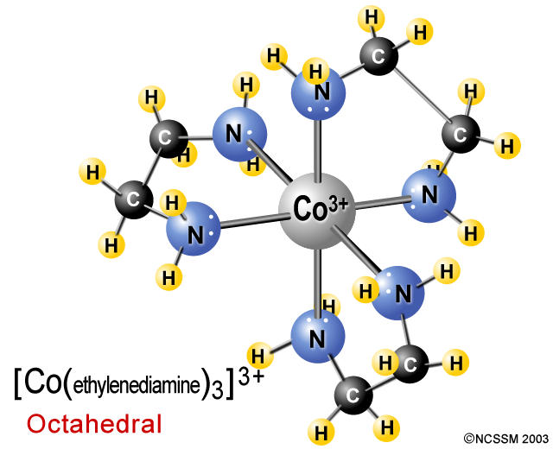
Factors Affecting the Magnitude of Crystal Field Splitting Δ
Size of the metal ion / Row to which the metal ion belong
Larger the size (row to which it belongs) larger the Δ value
[Co(en)₃]³⁺ 23,200 cm⁻¹
[Rh(en)₃]³⁺ 34,600 cm⁻¹
[Ir(en)₃]³⁺ 41,000 cm⁻¹
∼ 50% increase
∼ 25% increase
Consequence:
Second and third row transition metals will have greater tendency to form low spin complexes
Reason:
Around a large metal ion, a given set of ligands experience less steric crowding and therefore can approach closer to the metal ion. More closer- larger will be the splitting

Slide 20
Factors Affecting the Magnitude of Crystal Field Splitting Δ
Charge on the metal ion / Oxidation state of the metal ion
Greater the charge larger the Δ value
[Co(NH₃)₆]²⁺ 10,000 cm⁻¹
[Co(NH₃)₆]³⁺ 22,900 cm⁻¹
[Cr(H₂O)₆]²⁺ 14,000 cm⁻¹
[Cr(H₂ O)₆]³⁺ 17,400 cm⁻¹
Reason:
Higher the charge on the metal, the ligands are pulled in towards the metal more and therefore the ligands split the energies of the metal d orbitals to a greater extent

Slide 21
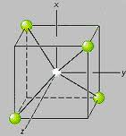
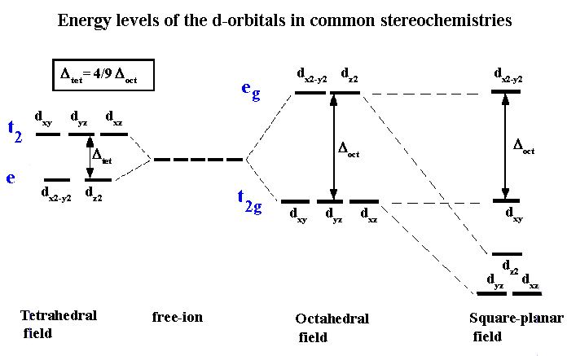
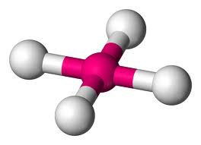
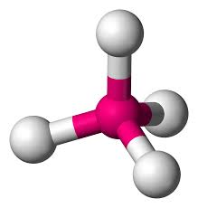
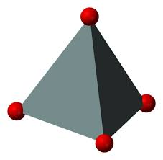
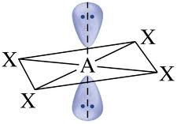
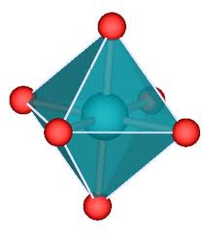
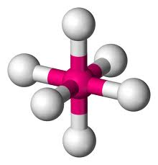
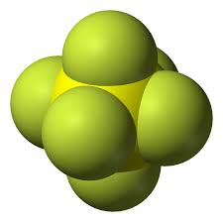
Factors Affecting the Magnitude of Crystal Field Splitting Δ
Number of ligands around the metal and shape of complex
(Octahedral, tetrahedral, square planar….
Δ_{SP} ≈ 1.74 Δ_{O}

Slide 22
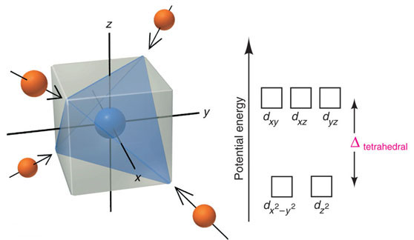
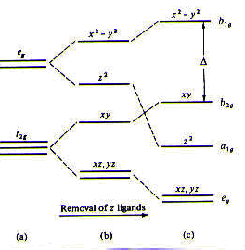
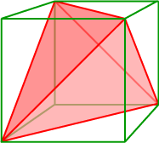
Splitting of d-orbitals by a tetrahedral field and a square planar field of ligands.
t₂
e
tetrahedral
square planar
Square planar is related to octahedral splitting:
Removing the axial ligands of an octahedron to infinity results in a square plane
Tetrahedron is related to cube in splitting of energy levels
Δ_{t} =¹/₂ Δ_{C}
Same arrangement of orbitals

Slide 23
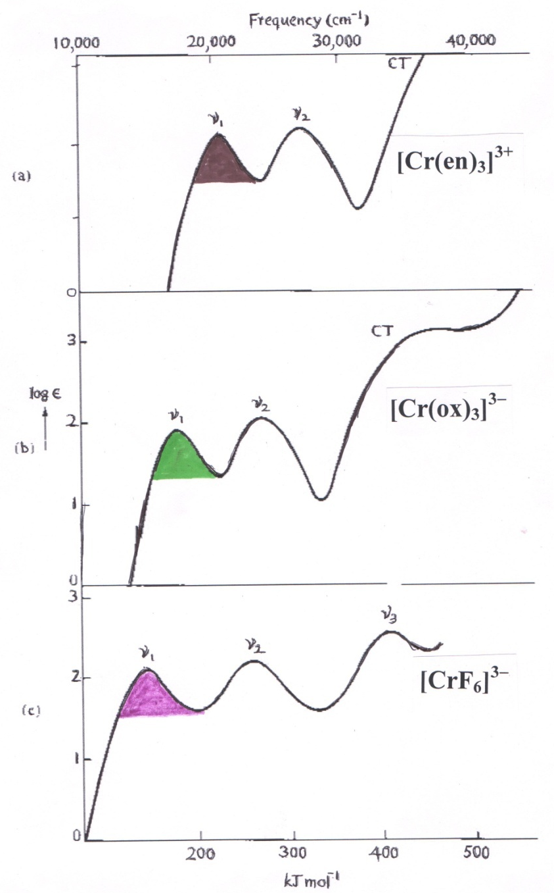
Factors affecting Δ; Strength of the Ligand
The effect of different ligands on the degree of Δ splitting is understood from the UV-Vis absorption spectra of complexes of the same metal-ion with different ligands
There is an increase in the frequency of the υ₁ (Δ_{o}) absorption band as the ligands on Cr³⁺ is changed from
F → O based→ N based ligands

Slide 24
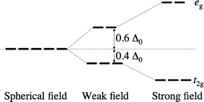
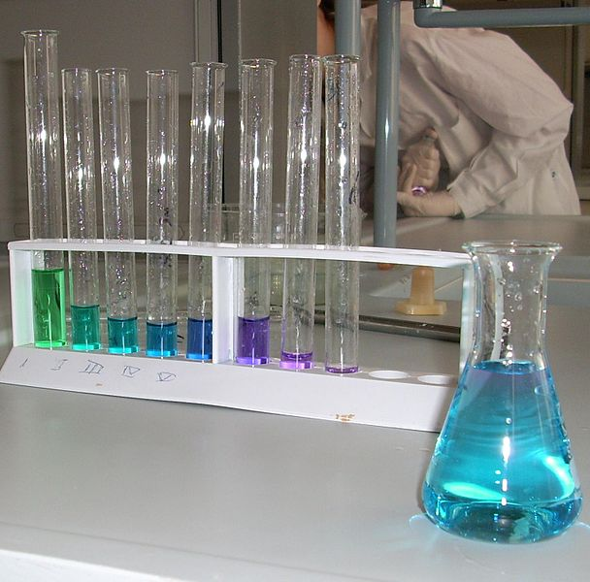
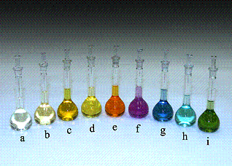
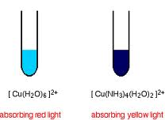
The Spectrochemical series
I ⁻ < Br ⁻ < S²⁻ < SCN ⁻ < Cl ⁻ < F ⁻ < OH ⁻ < Ox < ONO ⁻ < H₂O Weak field
< NCS⁻ < edta ⁴ ⁻ < NH₃ ∼ Py < en < bipy < Phen < NO₂ ⁻ < PPh₃ < CN⁻ ∼ CO Strong field
Halides ; sulfur donors < Oxygen donors < Nitrogen donors < CN-, CO
COBALT(III) Complexes of
(a) CN–, (b) NO₂–, (c) phen, (d) en, (e) NH₃, (f) gly, (g) H₂O, (h) ox^{2–}, (i) CO₃^{2–}
Stepwise addition of ‘en’ to [Ni(H₂O)₆]²⁺

Slide 25
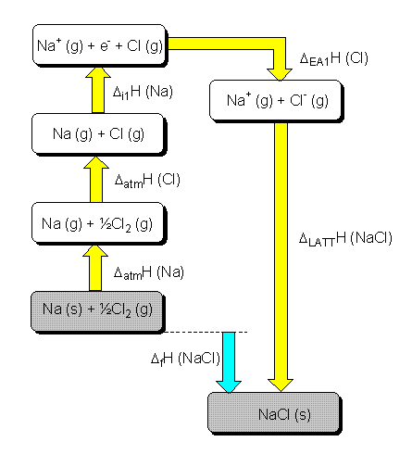
Crystal Field theory to explain observed properties of complexes:
Variation of some physical properties across a period:
Lattice energy of transition metal ions in a complex
Ionic radii of transition metal ions in a complex
Enthalpy of hydration of transition metal ions
Site preference of Spinels and Inverse spinels
Lattice Energy: Energy released when one mole of an ionic solid is formed from isolated gaseous ions
Calculated theoretically using the Born- Lande Equation
Experimentally determined using the Born- Haber cycle
Where
A = Madelung constant ( related to the geometry of the crystal)
N = Avogadro’s number
Z= Charge on the M+ and M- ions
₀= permittivity of free space
r₀ = distance to the closest ion
n= Born exponent (a number between 5 and 12)

Slide 26
Lattice Energies (1st Row Divalent Transition Metal Halides and Main group halides)
Compound | Lattice energy (KJ/mol) |  | Differences (KJ/mol)
 | Measured | Calculated
NaCl | -764 | -764 | 0
MgF₂ | -2908 | -2915 | +7
MnF₂ | -2770 | -2746 | +24
FeF₂ | -2912 | -2752 | -160
CuF₂ | -3042 | -2885 | -157
NiF₂ | -3046 | -2917 | -129
The discrepancy for a six- coordinate transition metal ion can be explained by CFSE

Slide 27
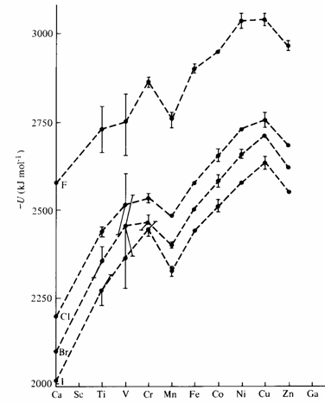
According to the Born –Lande Equation one can expect a smooth increase in lattice energies as we go from left to right due to decrease in ionic radius of the metal ions
As anticipated a smooth curve is not seen: instead a double hump shaped curve is obtained
Ca²⁺ (d⁰), Mn²⁺(d⁵ HS) and Zn²⁺ (d¹⁰) which in common have CFSE =0 lie almost on the expected line.
Ions such as V²⁺ which show high CFSE in a weak field situation with high lattice energy values show significant deviation from the calculated lattice energies

Slide 28
Ionic radii of transition metal ions in the presence of weak field and strong field ligands
One can expect decrease the ionic radii of the M ²⁺ ions smoothly from Ca²⁺ to Zn ²⁺ due to the increase in nuclear charge
But the plot shown below (left) for weak field ligands indicate that the expected regular decrease is absent expect for Ca²⁺, Mn ²⁺ and Zn ²⁺
For strong field ligands like CN- a different trend in variation is observed with a steady decrease till d⁶ (t_{2g}⁶)
+2 Oxidation state
+3 Oxidation state

Slide 29
Ionic radii of transition metal ions in the presence of weak field and strong field ligands
Why does the ionic radii decreases and then increases??
Ti²⁺ (d²) electron occupy only t_{2g}
V²⁺ (d³) electrons occupy only t_{2g}
Cr²⁺ (d⁴HS) electrons start occupying the e_{g} orbitals
As the e_{g} orbitals point directly towards the ligands, the repulsion between the metal electrons and ligand electrons will be higher than normal leading to the eventual increase in the ionic radius.
In the case of strong field ligand such as cyanide there will be a steady decrease in ionic radii till t_{2g}⁶ is reached.
The same tend is observed also for M³⁺ transition metal complexes

Slide 30
Variation of some physical properties across a period
Enthalpy of hydration of transition metal ions
It is the heat exchange involved when 1 mole of gaseous ions become hydrated
M_{(g)}²⁺ + excess H₂O [M(H₂O)₆]²⁺
The amount of energy released when a mole of the ion dissolves in a large amount of water forming an infinite dilute solution in the process.
Higher the charge on the ions and smaller the size, more exothermic will be the hydration energy. So it is expected to increase smoothly on going from left to right of the transition metals (green line in the graph)
The heats of hydration show two “humps” consistent with the expected CFSE for the metal ions. The values for d⁵ and d¹⁰ are the same as expected with a CFSE equal to 0.

Slide 31
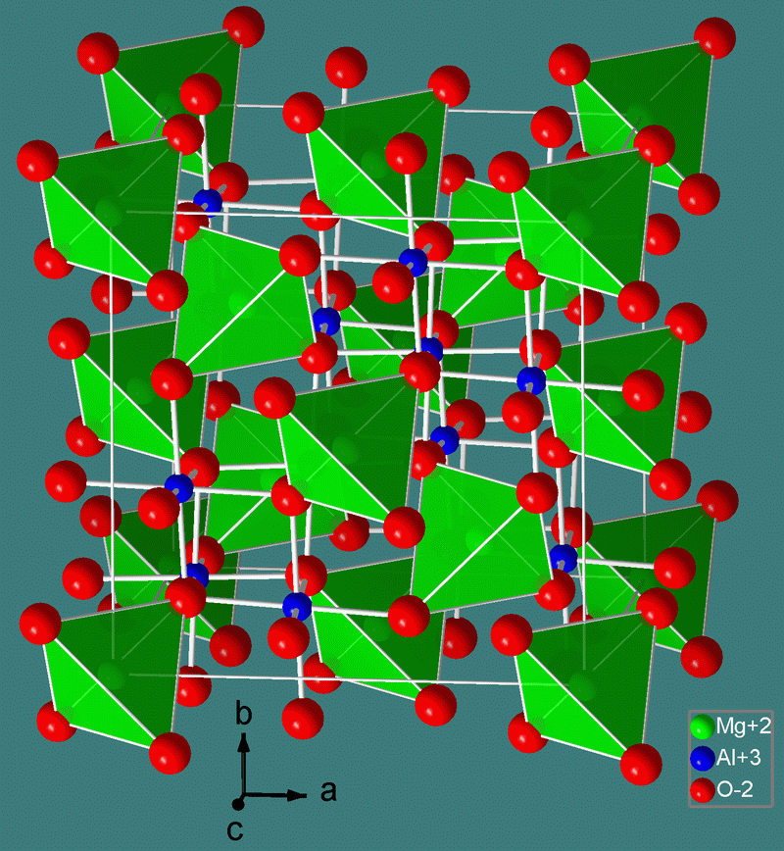
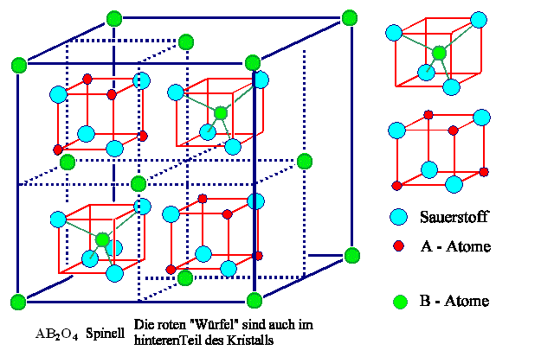
Site preference of Spinels and Inverse Spinels
Spinels are a class of crystalline solids of the general formula AB₂O₄ (A^{II}B ^{III}₂O₄ ) where
A = main group (Group IIA) or transition metal ion in the +2 oxidation state
B= main group (Group IIIA) or transition metal ion in the +3 oxidation state
The weak field oxide ions provide a cubic close-packed lattice. In one unit cell of AB₂O₄ there are 8 tetrahedral and 4 octahedral holes
Normal Spinel: A²⁺ ions occupy 1/8th of the Td holes
B³⁺ ions occupy ½ of the octahedral holes
Inverse Spinel: The +2 ion and one of the +3 ions exchange positions
i.e. Td holes: +3 ,
Oh holes: both +2 and +3 ions
Eg. MgAl₂O₄
_{Mg2+ Tetrahedral}
_{Al3+ octahedral}
Eg. Fe₃O_{4 (Magnetite)}
_{Fe3+ Tetrahedral}
_{Fe 2+, Fe3+ octahedral}

Slide 32
If A and B of AB₂O₄ are both s or p block elements (e.g. MgAl₂O₄) it always show Spinel structure
Question: Why does some AB₂O₄ compounds having transition elements as A and /or B prefer the inverse Spinel structure and some others normal Spinel structure?
ANS: Crystal Field Stabilization Energy in an octahedral site [Also given as Octahedral site stabilization energy (OSSE) in some books]
Mn₃O₄ = Mn^{II}Mn^{III}₂O₄
O²⁻ = a weak field ligand
Mn²⁺ = d⁵ HS : CFSE = 0
Mn³⁺ = d⁴ HS : CFSE = -0.6 Δ_{o}
Mn²⁺ by exchanging positions with Mn³⁺ in an octahedral hole is not going to gain any extra crystal field stabilization energy. While Mn³⁺ by being in the octahedral hole will have CFSE.
Therefore Mn₃O₄ will be Normal Spinel
Fe₃O₄ = Fe^{II}Fe^{III}₂O₄
Fe²⁺ = d⁶ HS : CFSE =-0.4 Δ_{o}
Fe³⁺ = d⁵ HS: CFSE = 0
Fe²⁺ by exchanging positions with Fe³⁺ to an octahedral hole is going to gain extra crystal field stabilization energy. While Fe³⁺ by being in the octahedral hole will not have any CFSE.
Therefore Fe₃O₄ will be Inverse Spinel

Slide 33
Magnetic properties of transition metal complexes
Magnet on:
Paramagnetic
Magnet off
Magnet on:
diamagnetic
Gouy balance to measure the magnetic susceptibilities

Slide 34
Magnetic properties of metal complexes
Magnetism is caused by moving charged electrical particles (Faraday, 1830s). These particles can be the current of electrons through an electric wire, or the movement of charged particles (protons and electrons) within an atom. These charged particles move much like planets in a solar system:
nucleus spin around its own axis, causing a very weak magnetic field.
electrons orbit around the nucleus, causing a weak magnetic field.
electrons spin around their own axis, causing a significant magnetic field .
Spinning electrons generate the bulk of the magnetism in an atom.
Within each orbit, electrons with opposite spins pair together, resulting in no net magnetic field. Therefore only unpaired electrons lead to magnetic moment
The spin-only formula (μ_{s})

Slide 35
Magnetic properties: Spin only and effective
The spin-only formula (μ_{s}) applies reasonably well to metal ions from the first row of transition metals: (units = μ_{B,}, Bohr-magnetons)
Metal ion d^{n} configuration μ_{s}(calculated) μ_{eff} (observed)
Ca²⁺, Sc³⁺ d⁰ 0 0
Ti³⁺ d¹ 1.73 1.7-1.8
V³⁺ d² 2.83 2.8-3.1
V²⁺, Cr³⁺ d³ 3.87 3.7-3.9
Cr²⁺, Mn³⁺ d⁴ 4.90 4.8-4.9
Mn²⁺, Fe³⁺ d⁵ 5.92 5.7-6.0
Fe²⁺, Co³⁺ d⁶ 4.90 5.0-5.6
Co²⁺ d⁷ 3.87 4.3-5.2
Ni²⁺ d⁸ 2.83 2.9-3.9
Cu²⁺ d⁹ 1.73 1.9-2.1
Zn²⁺, Ga³⁺ d¹⁰ 0 0

Slide 36
Spin and orbital contributions to μ_{eff}
For the first-row d-block metal ions the main contribution to magnetic susceptibility is from electron spin. However, there is also an orbital contribution (especially for the second and third row TM) from the motion of unpaired electrons from one d-orbital to another. This motion constitutes an electric current, and so creates a magnetic field.
spinning
electrons
d-orbitals
spin contribution – electrons are orbital contribution - electrons
spinning creating an electric move from one orbital to
current and hence a magnetic field another creating a current and hence a magnetic field

Slide 37
Crystal Field theory explains magnetic moments of TM complexes
Strength of the ligand, type of complex , size of the metal and its oxidation state affects crystal field splitting

Slide 38
Temperature dependence of magnetic moments
Fe(Phen)₂(NCS)₂
How crystal field theory explains temperature dependence of μ_{eff}
Fe²⁺ = d⁶

Slide 39
Ferromagnetism:
In a normal paramagnetic material, the atoms containing the unpaired electrons are magnetically dilute, and so the unpaired electrons in one atom are not aligned with those in other atoms.
In ferromagnetic materials, such as metallic iron, or iron oxides [magnetite (Fe₃O₄)], where the paramagnetic iron atoms are very close together, they can create an internal magnetic field strong enough that all the centers remain aligned:
unpaired electrons
oriented randomly
unpaired electrons aligned in their
own common magnetic field
unpaired electrons
paramagnetic,
magnetically
dilute in e.g.
[Fe(H₂O)₆]Cl₂.
b) ferromagnetic,
as in metallic
Fe or some
Fe oxides.
Fe
atoms
separated by
diamagnetic atoms
a) b)

Slide 40
Antiferromagnetism:
Here the spins on the
unpaired electrons
become aligned in
opposite directions so
that the μ_{eff} approaches
zero, in contrast to
ferromagnetism, where
μ_{eff} becomes very large.
An example of anti-
ferromagnetism is found
in MnO and oxymyloglobin.
electron spins in opposite
directions in alternate metal atoms
antiferromagnetism
Observed in Oxyhemoglobin and oxymyoglobin

Slide 41
Which is the strongest ferromagnetic material in the world?
NEODYMIUM MAGNET
Nd₂Fe₁₄B

Slide 42
IITD 2015 L2-S42
Problem solving !!
Cobalt form three octahedral complexes, [MCl₆]⁴⁻, [M(R₂NCS₂)₃] and [M(CN)₅(H₂O)]³⁻. These have magnetic moments 0, 1.73 and 3.9 BM (not in the order). Assign the moments to the complexes and predict the relative strength of the dithiocarbamate ligand.
Solution
[CoCl₆]⁴⁻ Co²⁺, 3d ⁷ ,Cl- weak ligand, HS, 3 unpaired e’s ~ 3.9 BM
[Co(CN)₅(H₂O)]³⁻. Co²⁺, CN- strong ligand, LS 1 unpaired e 1.73 BM
[Co(R₂NCS₂)₃], Co³⁺, 3d ⁶ , 0 BM means ligand is strong field and low spin complex

Slide 43
IITD 2015 L2-S43
Distortion of some octahedral complexes
All six Ni-O bonds
equal at 2.05 Å
two long axial
Cu-O bonds
= 2.45 Å
four short
in-plane
Cu-O bonds
= 2.00 Å
[Ni(H₂O)₆]²⁺
no distortion
[Cu(H₂O)₆]²⁺
distortion lengthens axial Cu-O’s

Slide 44
Orbital Degeneracy versus Electronic Degeneracy
Energy
Orbital degeneracy: The 5 d orbitals are of the same energy in spherical field. This orbital degeneracy is lifted (reduced) in an octahedral field (to t_{2g} and e_{g} )
5 d orbitals in a spherical field
Electronic Degeneracy : Case of t_{2g}¹
Here there are three different ways by which the single electron can occupy the t_{2g} orbitals. There are three possible electronic configurations which are of the same energy. Electronic degeneracy is present
Electronic Degeneracy : Case of t_{2g}³
Here there is only one way by which the three electron can occupy the t_{2g} orbitals. So there is no electronic degeneracy
e_{g}
e_{g}
e_{g}
e_{g}
t_{2g}
t_{2g}
t_{2g}
t_{2g}

Slide 45
Orbital Degeneracy versus Electronic Degeneracy
Energy
Orbital degeneracy: The 5 d orbitals are of the same energy in spherical field. This orbital degeneracy is lifted (reduced) in an octahedral field (to t_{2g} and e_{g} )
5 d orbitals in a spherical field
Electronic Degeneracy : Case of t_{2g}¹
Here there are three different ways by which the single electron can occupy the t_{2g} orbitals. There are three possible electronic configurations which are of the same energy. Electronic degeneracy is present
Electronic Degeneracy : Case of t_{2g}³
Here there is only one way by which the three electron can occupy the t_{2g} orbitals. So there is no electronic degeneracy
e_{g}
e_{g}
e_{g}
e_{g}
t_{2g}
t_{2g}
t_{2g}
t_{2g}

Slide 46
Ni(II)
Cu(II)
High-spin Ni(II) – only one way of filling the e_{g} level
– not electronically degenerate
Cu(II) – two ways of filling the e_{g} level – it is electronically degenerate
Cu(II)
d⁹
Ni(II)
d⁸
Energy
e_{g}
e_{g}
e_{g}
t_{2g}
t_{2g}
t_{2g}
What is the consequence of ELECTRONIC DEGENERACY ?

Slide 47
Distortion of the shape of complexes: The Jahn-Teller Effect
Hermann Arthur Jahn
English Scientist of German Origin
Edward Teller
father of the hydrogen bomb
Director of Lawrence Livermore National Laboratory
The Jahn–Teller theorem states that any nonlinear molecule with an electronic degenerate ground state will undergo a geometrical distortion that removes the degeneracy, lowers the symmetry because the distortion lowers the overall energy of the species.
The Jahn-Teller effect predicts which structures will distort. It does not predict the nature or extent of the distortion. The effect is more significant when the electronic degeneracy is in the orbitals that point directly towards the ligands.
" H. Jahn and E. Teller (1937). "Stability of Polyatomic Molecules in Degenerate Electronic States. I. Orbital Degeneracy". Proceedings of the Royal Society A 161 (905): 220–235.

Slide 48
Degeneracy in the t_{2g} orbital
Not so significant Jahn Teller distortion
Distortion manifested as the
Splitting of UV Vis peaks
e_{g}
Rb₂Na[TiCl₆]
Ca₂K [TiCl₆]
Rb₃[TiCl₆]
t_{2g}
[Ti(H₂O)₆]³⁺
No Measurable differences in bond lengths
Degeneracy in the e_{g} orbital
Significant Jahn Teller distortion
e_{g}
t_{2g}
Measurable differences in bond lengths

Slide 49
d-Electron configurations which show Jahn Teller distortions
NO electronic degeneracy:
NO Jahn Teller Distortion
Normal Jahn Teller Distortion
Degeneracy in t_{2g}
Significant Jahn Teller Distortion
Degeneracy in e_{g}

Slide 50
Structural effects of Jahn-Teller distortion on [Cu(en)₃]²⁺
N
N
N
Short
in-plane
Cu-N
bonds of
2.07 Å
Cu
N
N
N
long axial Cu-N
bonds of 2.70 Å
Chelation versus Jahn Teller distortion : Two opposing forces
consequence: low stability of such complexes

Slide 51
Tetragonal z out distortion extended : The Square Planar Case

Slide 52
Problem solving!
[Co(en)₃]²⁺, [Fe(CN)₆]⁴⁻, [Fe(CN)₆]³⁻, [CrF₆]⁴⁻
Classify the above given octahedral complexes and write in the boxes below as those
Having no tetragonal distortion | Having slight tetragonal distortion which is seen from UV Visible spectral studies | Having significant tetragonal distortion indicated as varying bond distances in their structure
[Co(en)₃]²⁺
Co²⁺ = 3d⁷
en=strong field
e_{g}
Electronic degeneracy in the e_{g} orbital =
Significant Jahn Teller distortion
t_{2g}

Slide 53
Color
BY CHRISTINA ROSSETTI 1830–1894
What is pink? a rose is pink
By a fountain's brink.
What is red? a poppy's red
In its barley bed.
What is blue? the sky is blue
Where the clouds float thro'.
What is white? a swan is white
Sailing in the light.
What is yellow? pears are yellow,
Rich and ripe and mellow.
What is green? the grass is green,
With small flowers between.
What is violet? clouds are violet
In the summer twilight.
What is orange? Why, an orange,
Just an orange!
Source: The Golden Book of Poetry (1947)
Factors to be explained
1. Frequency /Wavelength of color
2. Intensity of the color

Slide 54
Colors and complementary colors of transition metal complexes
Yellow-------Violet
Green--------Purple
Blue green----Red
Blue------orange
Yellow green----purple violet
Complementary color is the color generated from the left over wavelengths of light after certain wavelengths are absorbed by the compound under study.

Slide 55
Effects of the metal oxidation state and of ligand strength on color.
[V(H₂O)₆]²⁺
[V(H₂O)₆]³⁺
560 nm
17900 cm⁻¹
460 nm
21700 cm⁻¹
540 nm
18500 cm⁻¹
[Cr(NH₃)₆]³⁺
460 nm
21700 cm⁻¹
[Cr(NH₃)₅Cl ]²⁺

Slide 56
Ni(en)₃
Ni(NH₃)₆
Ni(H₂O)₆
Cl ⁻ < F ⁻ < Ox < ONO ⁻ < H₂O < edta ⁴ ⁻ < NH₃ ∼ Py < en < bipy < Phen < PPh₃ < CN⁻ ∼ CO

Slide 57
The electronic spectrum of [Ni(H₂O)₆]²⁺:
The complex looks green, because it absorbs only weakly at 500 nm,
the wavelength of green light. It absorbs in the red region 620-750 nm which is the
complimentary color of green
UV
visible
infrared
[Ni(H₂O)₆]²⁺
Δ₀
green
red
λ,

Slide 58
Visualization of color as transmitted light which is not absorbed
Gem Stones : Ruby and Emerald
corundum (Al₂O₃) and Ruby: corundum with chromium as impurity.
Mineral beryl (Be₃Al₂(SiO₃)₆), and Emerald: Beryl colored green by trace amounts of chromium and/ or vanadium
In real systems there are regions of different light absorptions leading to a wide range of colors. Strong transmission can dominate a weak transmission.

Slide 59
Problem solving!
[Co(NH₃)₆]³⁺ is diamagnetic and orange yellow. [CoF₆]³⁻ on the other hand is paramagnetic and blue . Why ?
[Co(NH₃)₆]³⁺: t_{2g}⁶ diamagnetic = no unpaired electrons
Orange yellow means absorption in the Violet-blue region (higher frequency, larger Δ_{o}) d⁶ LS
[CoF₆]³⁻ paramagnetic t_{2g}⁴e_{g}²
Blue means absorption in the orange region (lower frequency, smaller Δ_{o}) therefore d⁶ HS
Δ_{o} splitting magnitude is higher for [Co(NH₃)₆]³⁺ due to stronger ligand.

Slide 60
Colors of transition metal complexes:
Intensity of Color
.
How intensity of color is expressed
The molar absorption coefficient, molar extinction coefficient, or molar absorptivity (ε), is a measurement of how strongly a chemical species absorbs light at a given wavelength. It is an intrinsic property of the species; the actual absorbance A, of a sample is dependent on the pathlength, ℓ, and the concentration, c, of the species via the Beer–Lambert law,
Selection rules:
Electronic transitions in a complex are governed by Selection rules
A selection rule is a quantum mechanical rule that describes the types of quantum mechanical transitions that are permitted.
They reflect the restrictions imposed on the state changes for an atom or molecule during an electronic transition.
Transitions not permitted by selection rules are said forbidden, which means that theoretically they must not occur (but in practice may occur with very low probabilities).

Slide 61
1. Laporte Selection Rule
Statement : Only allowed transitions are those occurring with a change in parity (flip in the sign of one spatial coordinate.) OR During an electronic transition the azimuthal quantum number can change only by ± 1 (Δ l = ±1)
The Laporte selection rule reflects the fact that for light to interact with a molecule and be absorbed, there should be a change in dipole moment.
Otto Laporte
German American Physicist
Practical meaning of the Laporte rule
Allowed transitions are those which occur between gerade to ungerade or ungerade to gerade orbitals
Allowed
g u & u g
Not allowed (FORBIDDEN)
g g & u u
Gerade = symmetric w r t centre of inversion
Ungerade = antisymmetric w r t centre of inversion
This rule affects Octahedral and Square planar complexes as they have center of symmetry.
Tetrahedral complexes do not have center of symmetry: therefore this rule does not apply
t_{2g} e_{g} is forbidden OR
According to Laporte selection rule d→d transitions are not allowed !

Slide 62
2. Spin Selection Rule
Statement : This rule states that transitions that involve a change in spin multiplicity are forbidden. According to this rule, any transition for which Δ S = 0 is allowed and Δ S ≠ 0 is forbidden
Practical significance of the Spin Selection rule
During an electronic transition, the electron should not change its spin
d⁵ High spin (e.g [Mn(H₂O)₆]²⁺
e_{g}
e_{g}
hν
[GS]
[ES]
[GS]
[ES]
t_{2g}
t_{2g}
S = 0
Allowed
S ≠ 0
Forbidden
S ≠ 0 Forbidden

Slide 63
Why do we see ‘forbidden’ transitions at all?
Relaxation of the selection rules
There are three mechanisms that allow ‘forbidden’ electronic transitions to become somewhat ‘allowed’ resulting in some intensity of the color expected.
Vibronic Coupling: During some unsymmetrical vibrations of a molecule there can be a temporary/transient loss of the centre of symmetry. Loss of center of symmetry helps to overcome the Laporte selection rule. Also time required for an electronic transition to occur (lifetime 10⁻¹⁸ sec) is much less than the time required for a vibration to occur (lifetime 10⁻¹³ sec
Mixing of states: The states in a complex are never pure, and so some of the symmetry properties ( g or u) of neighboring states become mixed into those of the states involved in a ‘forbidden’ transition. For example mixing of d (gerade) and p (ungerade) orbitals results in partial breakdown of the Laporte rule
3) Spin orbit coupling: Partial lifting of the spin selection rule is possible when there is coupling of the spin and orbital angular momentum, known as the spin-orbit coupling ( common in heavier transition metals)
[Mn(H₂O)₆]²⁺

Slide 64
The spectra of complexes of tetrahedral metal ions:
As we have seen, a tetrahedron has no center of symmetry, and so orbitals in such symmetry cannot be gerade. Hence the d-levels in a tetrahedral complex are e and t₂, with no ‘g’ for gerade.
This largely overcomes the Laporte selection rules, so that tetrahedral complexes tend to be more intense in color. Thus, we see that dissolving CoCl₂ in water produces a pale pink solution of [Co(H₂O)₆]²⁺, but on adding HCl tetrahedral [CoCl₄]²⁻ forms, which has a very intense blue color.
Cobalt blue was known in China before 1400 BC when it was used for pottery glazes, but it was always a rare pigment because cobalt minerals were scarce. Today, cobalt is still used to colour porcelain, pottery, glass, tiles and enamel jewellery. Its rich blue colour is also known as Sèvres blue and Thénard blue

Slide 65
The spectra of octahedral [Co(H₂O)₆]²⁺ and tetrahedral [CoCl₄]²⁻ ions:
[CoCl₄]²⁻
Intense d-d bands in the blue
tetrahedral complex [CoCl₄]²⁻, as compared with the much weaker
band in the pink octahedral complex
[Co(H₂O)₆]²⁺. This difference arises
because the T_{d} complex has no center of symmetry, helping to
overcome the g→g Laporte selection rule.
[Co(H₂O)₆]²⁺

Slide 66
Classification of intensities of electronic transitions
Transition type | Example | Typical values of ε /m²mol⁻¹
Spin forbidden, Laporte forbidden (partly allowed by spin–orbit coupling) | [Mn(H₂O)₆]²⁺ | 0.1
Spin allowed (octahedral complex), Laporte forbidden (partly allowed by vibronic coupling and d-p mixing) | [Co(H₂O)₆]²⁺ | 1 - 10
Spin allowed (tetrahedral complex), Laporte allowed (but still retain some original character) | [CoCl₄]²⁻ | 50 - 150
Spin allowed, Laporte allowed e.g. charge transfer bands | KMnO₄ | 1000 - 10⁶

Slide 67
Molecular orbital picture required to explain charge transfer spectra
Includes both σ and π (back bonding) bonding
t_{1u}
KMnO₄ Prussian Blue Ferric Thiocyanate Pot. Dichromate

Slide 68
What happens if the absorption of electromagnetic radiation for an octahedral complex falls in the ultra violet range?
Cr(CO)₆
Mo(CO)₆ Colorless
W(CO)₆
However some complexes also show a phenomenon known as Fluorescence
Fluorescence is the emission of light by a substance that has absorbed light or other electromagnetic radiation. In most cases the emitted light has a longer wavelength and a lower energy than the absorbed radiation.
So if such complexes are irradiated with UV light, the excited electron will lose some energy and then fall back to ground state emitting (fluorescent) light in the visible range

Slide 69
Emission spectra, Black light, UV-A radiation and fluorescence
Zn₂SiO₄
Quinine

Slide 70
Advantages and Disadvantages of Crystal Field Theory
Advantages over Valence Bond theory
Explains colors of complexes
Explains magnetic properties of complexes ( without knowing hybridization) and temperature dependence of magnetic moments.
Classifies ligands as weak and strong
Explains anomalies in physical properties of metal complexes
Explains distortion in shape observed for some metal complexes
Disadvantages or drawbacks
Evidences for the presence of covalent bonding ( orbital overlap) in metal complexes have been disregarded.
e.g Does not explain why CO although neutral is a very strong ligand
Cannot predict shape of complexes (since not based on hybridization)
Charge Transfer spectra not explained by CFT alone

Slide 71
Problem Solving
Arrange the given metal complexes in the increasing order of intensity of color (ε) shown by them. Justify your order by writing below each the status of the selection rules for these complexes (no partial marks)
Fe₄[Fe(CN)₆]₃ , [CoBr₄]²⁻, [MnF₆]⁴⁻, [Co(H₂O)₆]²⁺
[MnF₆]⁴⁻
Fe₄[Fe(CN)₆]₃
[CoBr₄]²⁻
Least intense |  |  | Most intense
Spin Forbidden Laporte Forbidden | Spin Allowed Laporte Forbidden | Spin Allowed Laporte Allowed (Tetrahedral) | Spin Allowed Laporte Allowed Charge – Transfer transition

